Slide 1
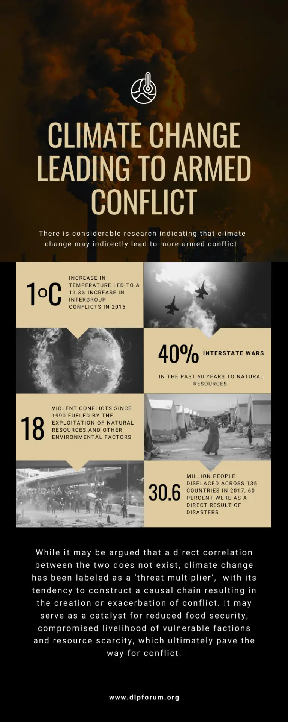

Slide 2
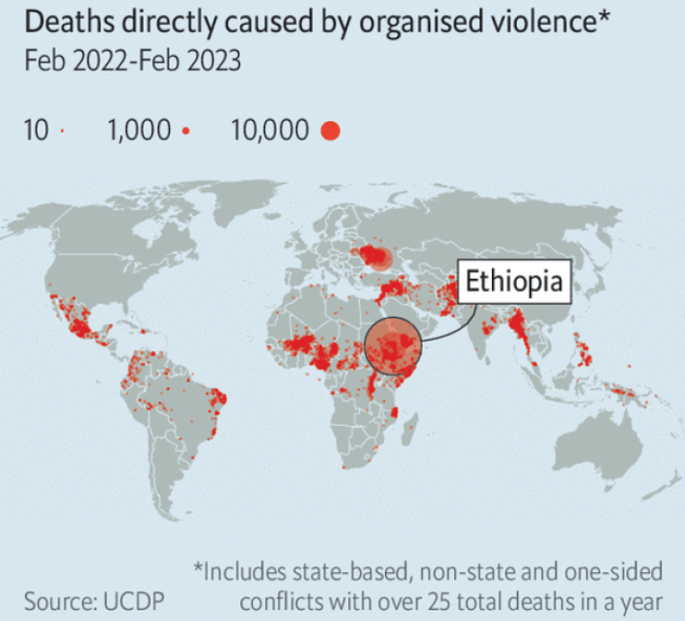
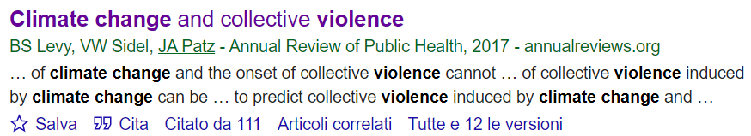
Motivation
Increasing evidence indicates that climate change is causally associated with collective violence, generally in combination with other causal factors (Climate change and collective violence, 2017)
Many quantitative studies examined different types of human conflict, associated with different climate variables, at different spatial and temporal scales.

Slide 3
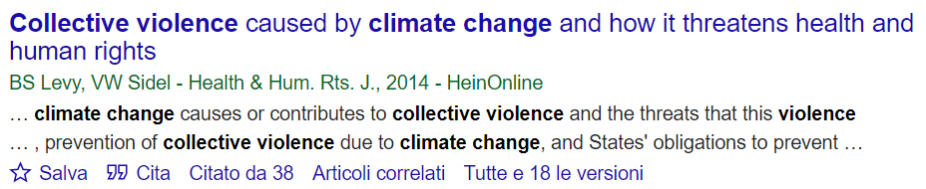
“The weight of scientific evidence indicates that climate change is causally associated with collective violence. This evidence arises from individual studies over wide ranges of time and geographic location, and from two extensive meta-analyses. Complex pathways that underlie this association are not fully understood; however, increased ambient temperatures and extremes of rainfall, with their resultant adverse impacts on the environment and risk factors for violence, appear to play key roles.”

Slide 4
Broad room for investigation
Climate events
Temperatures
Rainfall anomalies
Droughts
Floods
ENSO
NDVI anomalies
Sea-surface temperature changes
Weather-related natural disasters
Causal Mechanisms
Food/water security
Migration
Livestock price shocks
Intra-regime instability
Health and human rights
Ecosystem degradation
Conflict types
Protests
Riots
Battles
Explosions/remote violence
Violence against civilians
Interpersonal
Intergroup
There is no consensus on the causal association between observed climate change and conflicts (IPCC 2022, 4-54)
However, researchers agree that climate change contributes to increased conflict, along indirect pathways
causal chain resulting in the creation or exacerbation of conflict

Slide 5
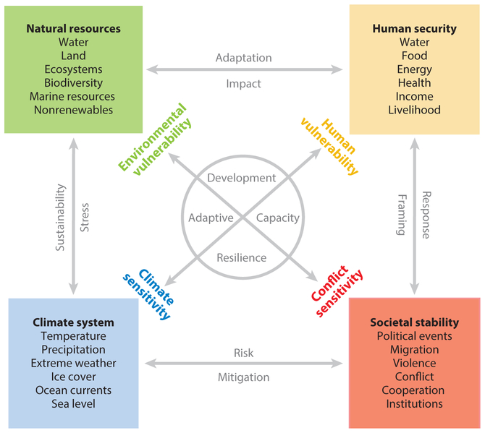
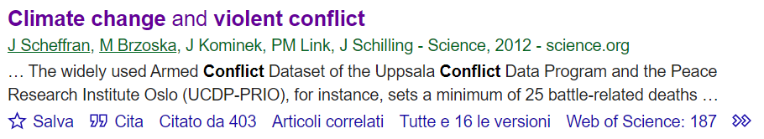
complex pathways connecting climate and conflict

Slide 6
Examples
The conflict in Sudan’s Darfur : correlation of resource scarcity due to rapid desertification and drought with the erosion of peaceful coexistence of the African and Arabic agriculturist communities.
Water scarcity driven by climate change linked to the civil war in Syria
Vanuatu witnessed a 300% increase in new domestic violence cases, reported by the Tanna Women’s Counselling Centre, after two tropical cyclones hit the Western division of Fiji in 2012.
A decade-long drought causing shrinkage of Lake Chad gave rise to confrontations and competition between farmers.
Literature focusing on South Asia and South-East Asia categorize the regions as being greatly affected by both climate change and conflict.
Floods were seen to augment the support and strength of the Islamist group Jamaat-ud-Dawa in Pakistan.
In conflict-ravaged nations such as Yemen and Somalia, devastating floods and droughts kill hundreds of people and force tens of thousands to migrate from their homes.
 | PRO | CONS
Case studies | More accurate | Not robust to generalization, complex to be parametrized
General models | Generality | Difficult to be applied to single cases due to the high variability of situations (useless)

Slide 7

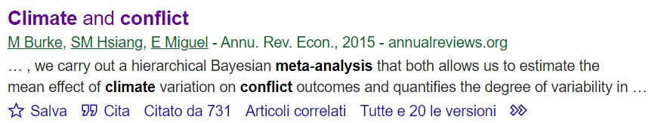
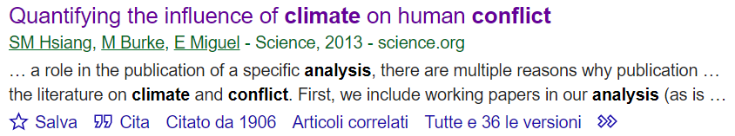
Meta Analysis
Catastrphic climate events as well as deviations from normal precipitation and temperatures lead to resource scarcity
This causes migration and the emergence of new conflicts, or it triggers existing, latent conflicts
This relationship is apparent across all spatial scales and temporal scales
Cross-sectional approaches (populations inhabiting different locations are assumed to be identical)
Times-series variation (single population is both the control and the treatment population)
Use natural experiments : variations in climate over time that are independent of other variables that also affect conflict.

Slide 8
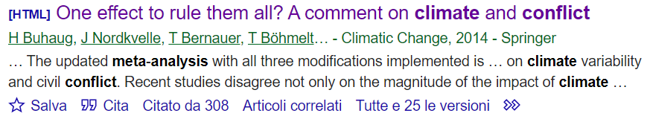
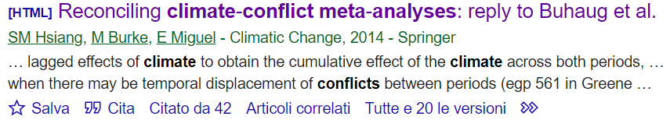
Meta Analysis
Problems :
Can statistical relationships be interpreted causally?
Results :
The effect of temperature is generally larger than the effect of rainfall
The effect on intergroup violence is larger than the effect on interpersonal violence.
Warmer temperatures, lower or more extreme rainfall, or warmer El Niño– Southern Oscillation (ENSO) conditions lead to an increase in the conflict

Slide 9
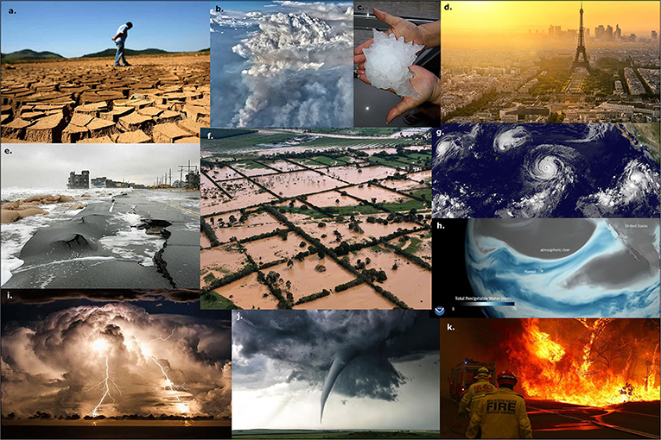
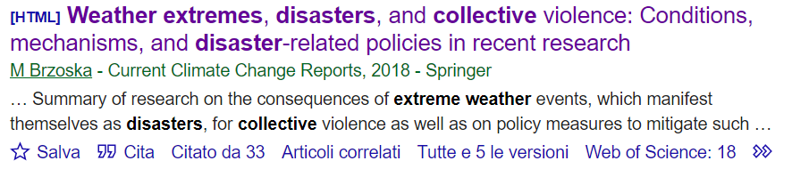
Weather-related natural disasters
Extreme events are rarely triggers but more often accelerators of dynamics that are already developing.
The increased likelihood of the initiation of collective violence seems to be primarily driven by droughts in ethnically divided societies.
For other forms of disasters, as well as droughts in societies not marked by ethnic conflict, research has not come to clear results.
Lower-level violence, particularly food riots, is more likely to be related to climate extremes than armed conflict.

Slide 10
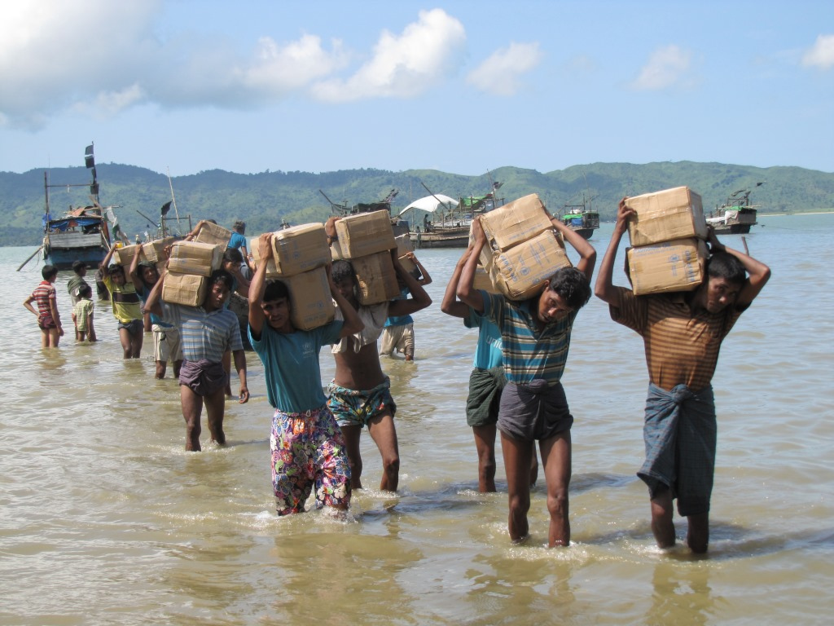
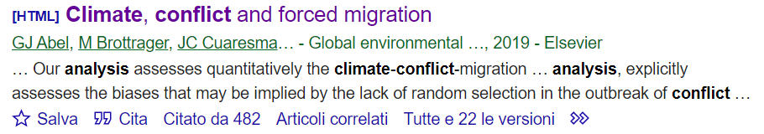
Migration and climate change
Examines the causal link between climate, conflict and forced migration
Climate change-induced migration promotes conflict in migrant receiving areas.
Climatic conditions, by affecting drought severity and the likelihood of armed conflict, played a significant role as an explanatory factor for asylum seeking in the period 2011–2015.
Particularly relevant for countries in Western Asia in the period 2010–2012.
The impact of climate on conflict and asylum seeking flows is limited to specific time period and contexts.

Slide 11
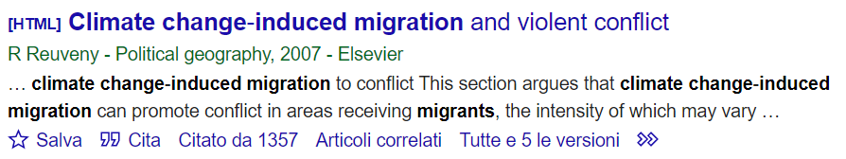
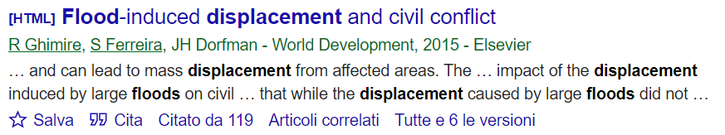
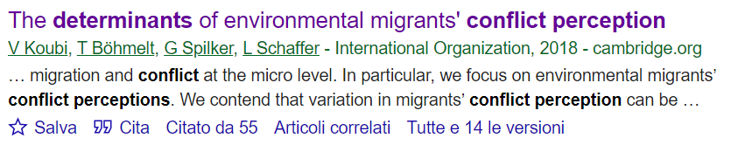
Migration and climate change
People living in lesser developed countries may be more likely to leave affected areas, which may cause conflict in receiving areas
Analysis of the role of large floods on the onset and prevalence of internal armed conflict.
Focus on the displacement induced by floods as a determinant of armed conflict.
Environmental migrants who suffer from environmentally induced grievances are more likely to perceive conflict and challenges in their new locations

Slide 12
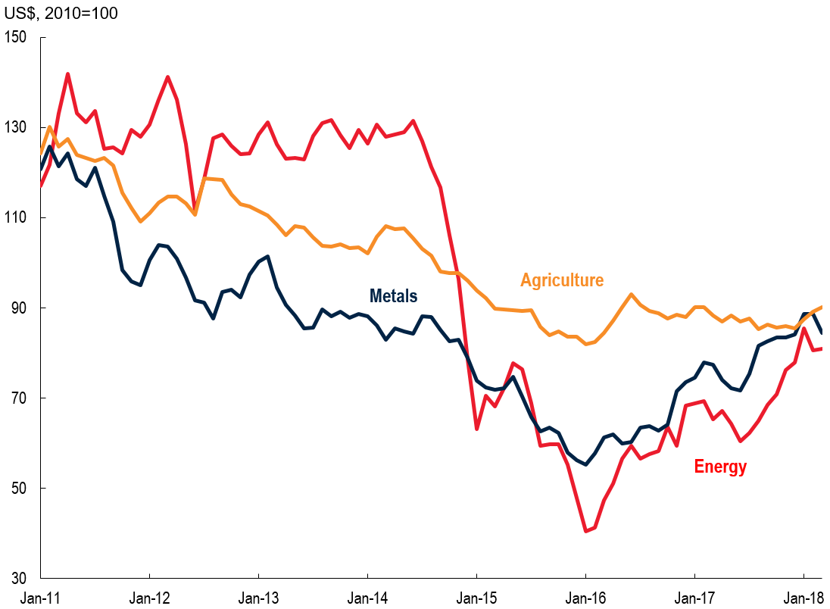
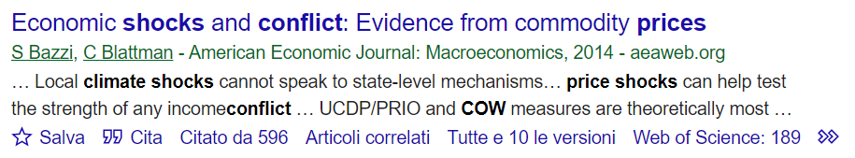
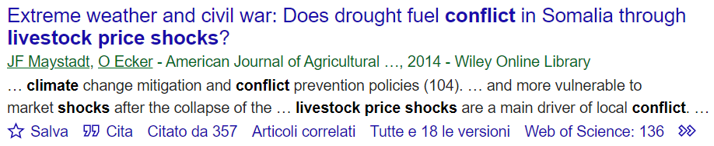
Economy and livestock price shocks
Is this relationship causal?
Three theories linking income to conflict are tested with new data on export price shocks
Drought affects conflict through livestock price changes, establishing livestock markets as the primary channel of transmission in Somalia.

Slide 13
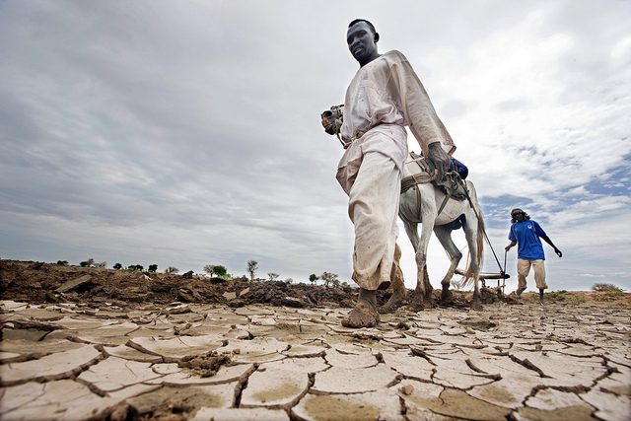
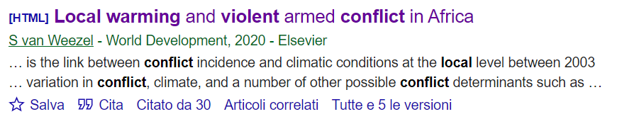
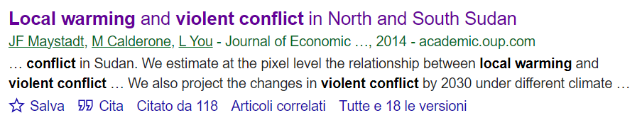
Local warming - temperatures
It uses long term changes in local climate to proxy climate change, rather than using weather variation.
Estimates not robust to adjustment for country-level factors such as institutional quality or colonial history.
Competition over natural resources, in particular water, is the main driver of such relationship in a region where pastoralism constitutes the dominant livelihood

Slide 14
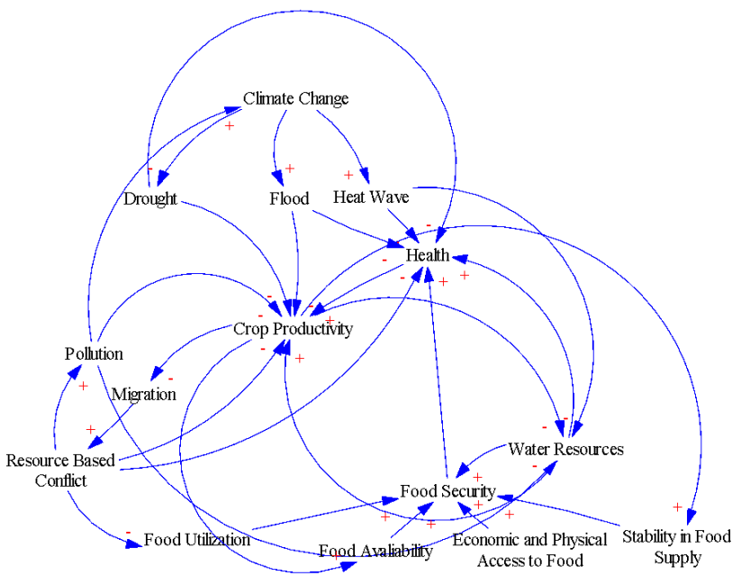

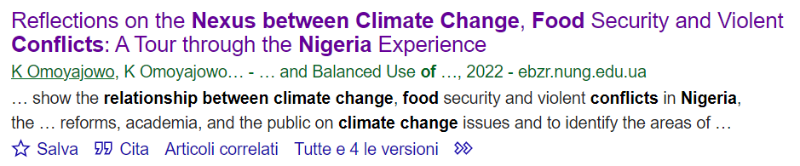
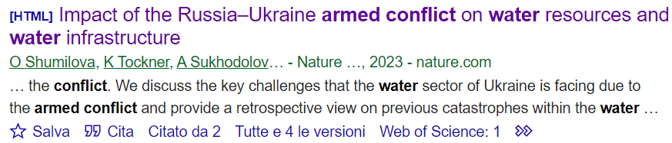
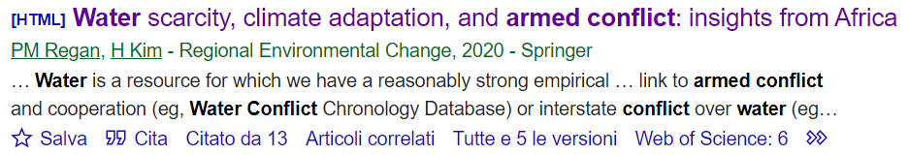
Food/water security
Analysis of the impacts of the military actions on freshwater resources and water infrastructure during the conflict
They empirically examine the effects of climatic conditions on the probability of armed conflict in Africa.
There are close links between climate drivers and armed conflict.
Greater levels of adaptive capacity lead to a lower likelihood of armed conflict.

Slide 15


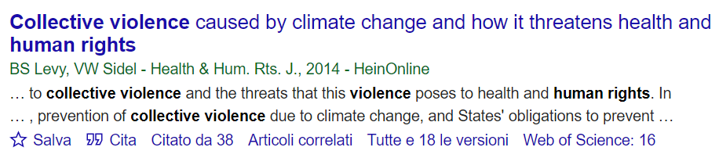
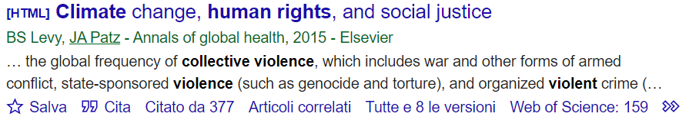
Health and human rights
Collective violence due to climate change poses serious threats to health and human rights:
directly by causing morbidity and mortality
indirectly by causing damage to the health-supporting infrastructure of society, forcing people to migrate, damaging the environment, and diverting human and financial resources
The environmental and health consequences of climate change, which disproportionately affect low-income countries and poor people in high-income countries, profoundly affect human rights and social justice.

Slide 16

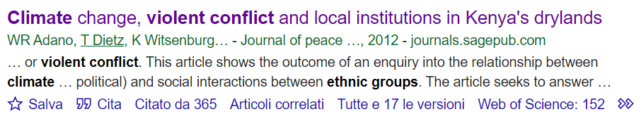
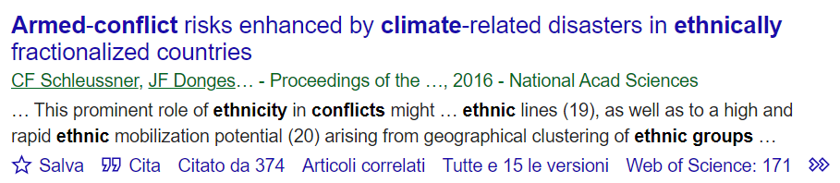
Local institutions, ethnic groups
Case studies on livelihood and poverty can shed light on how violence manifests as collective action or individual decisions, and how specific climatic conditions may inform or explain such violence.
Ethnic divisions often fuel armed conflicts worldwide, particularly when societal tensions rise rapidly due to events like natural disasters.

Slide 17

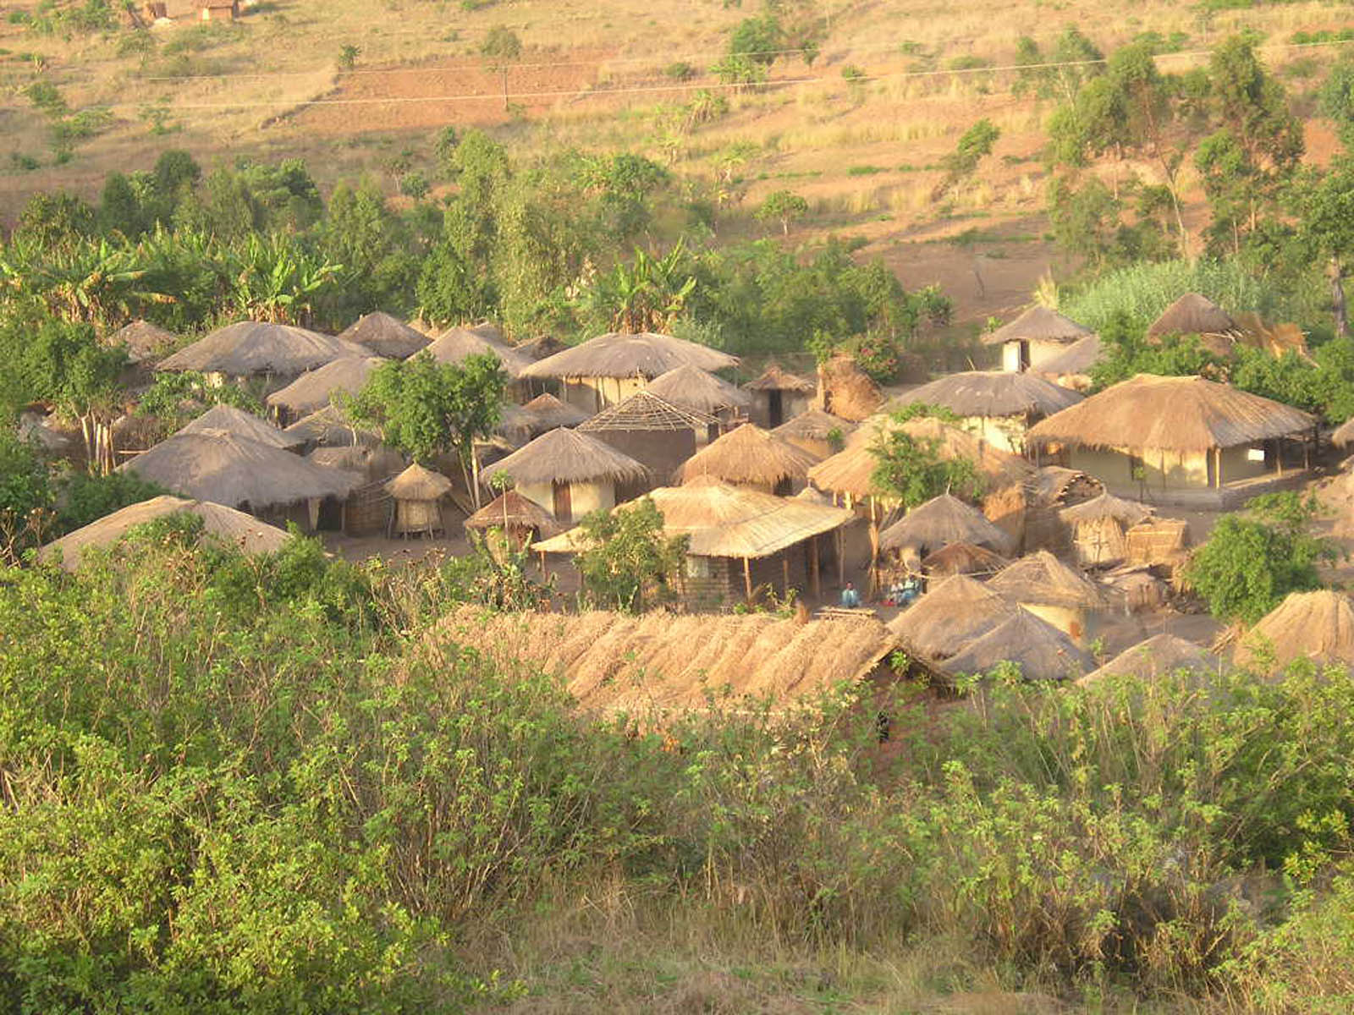
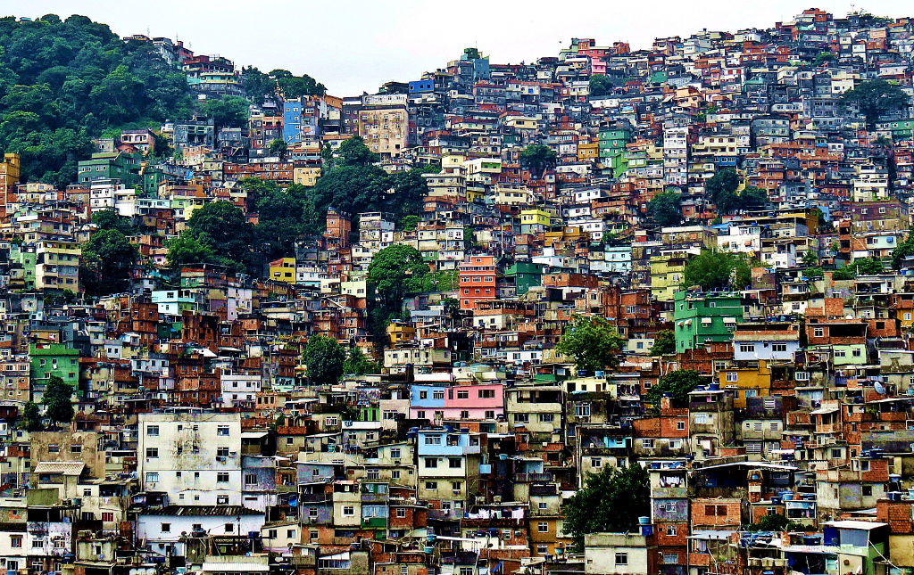
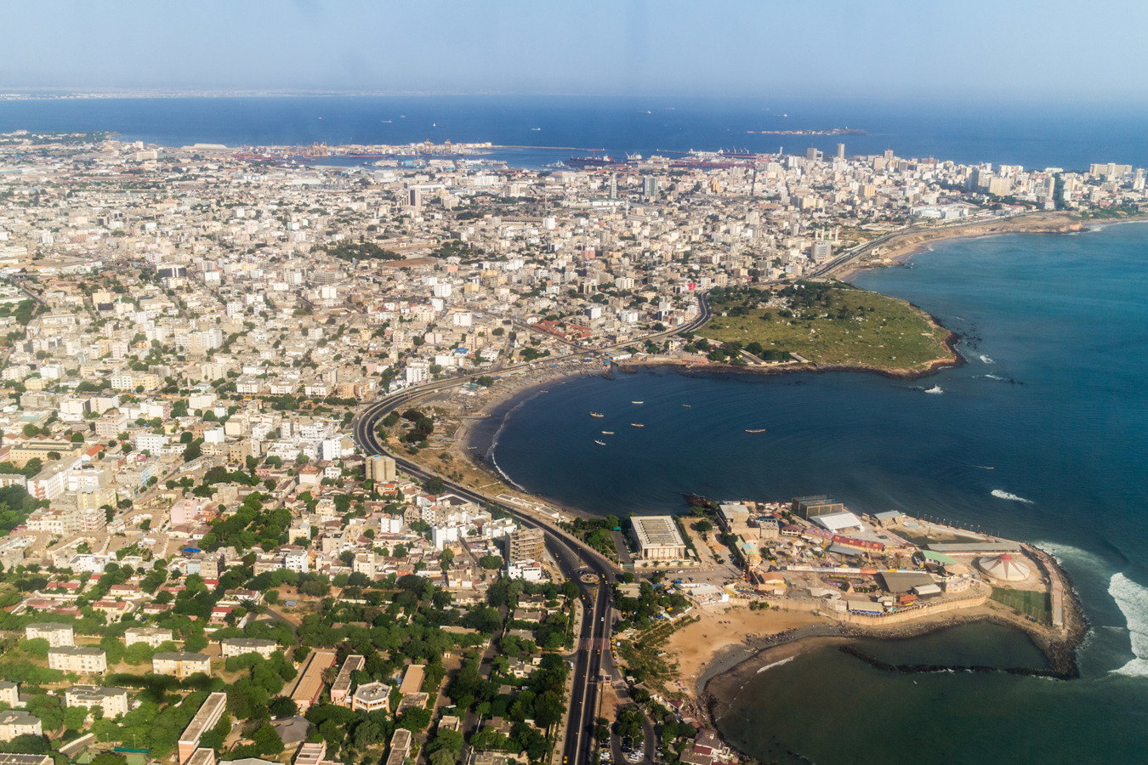

Characteristics of societies
Societies differ with respect to environmental vulnerability, coping capacity and ability to adapt, and also with respect to exogenously defined drivers of latent conflict risk.
Characteristics of societies :
population types
population size
ethnic composition
ecological diversity
economic performance
extent of democratic institutions
Which segments of society are affected :
Farmers
pastoralists
urban poor
political elite
…

Slide 18
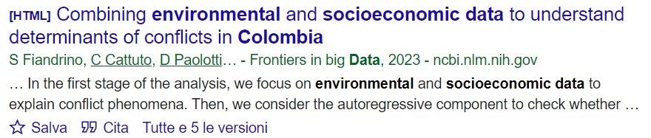
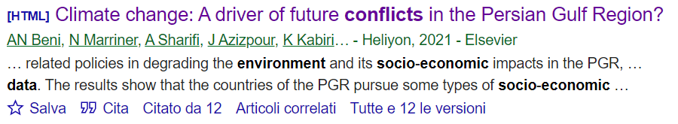

Particular socio-economic situations
Environmental and socioeconomic data
used to explain conflict phenomena
drug trafficking
political crises in oil-dependent economies
population growth and urbanization cause pressure on limited land resources

Slide 19
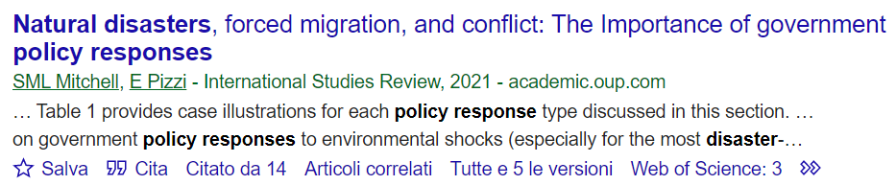
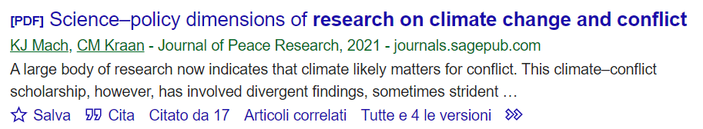
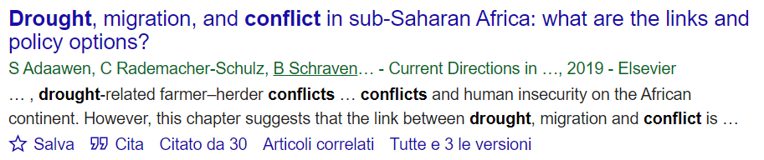
Policy responses
The identification of key drivers of violence is crucial to have evidence to inform subnational governments and to support the decision-making policies that could assess targeted policy options.
Analysis of government policies to identify trigger situations where disasters and migration are most likely to produce violence
The climate–conflict relationship has involved divergent findings, sometimes strident disagreement
limits the usability of the research for policymakers and practitioners

Slide 20
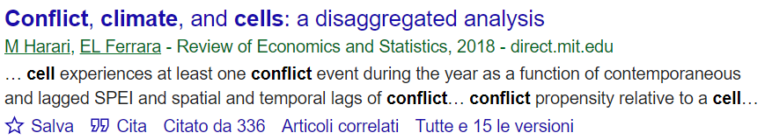
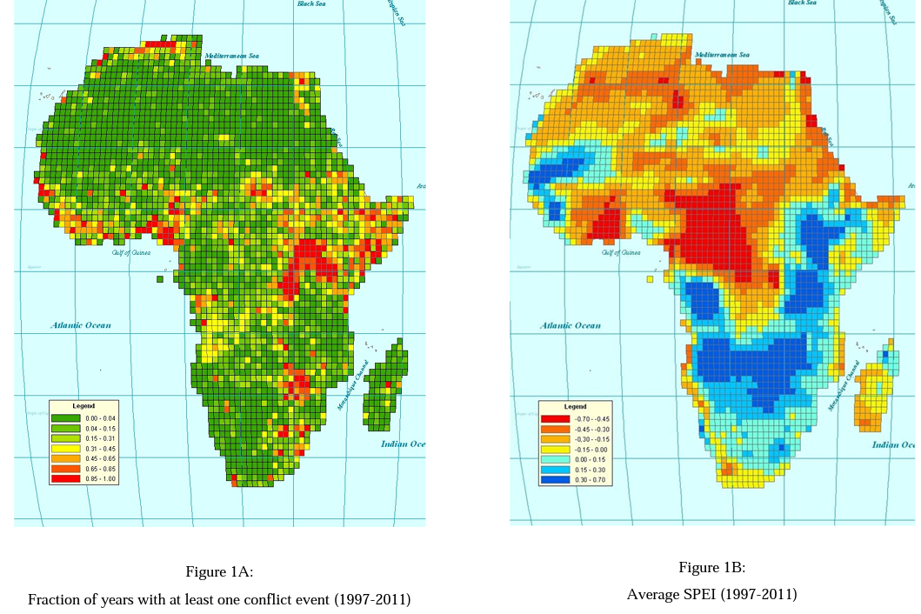
Gridded data set
Disaggregated empirical analysis of civil conflict at the subnational level in Africa over 1997 to 2011 using a new gridded data set.
Standardized Precipitation-Evapotranspiration Index

Slide 21

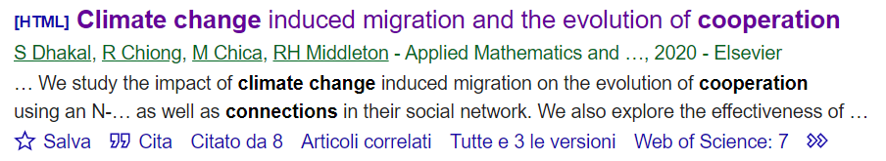
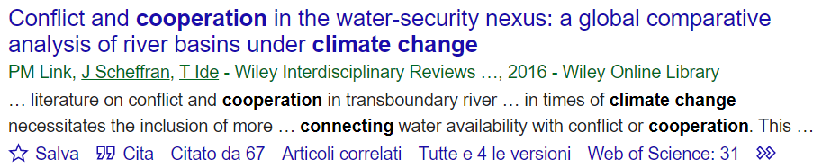
Climate change–cooperation connection
One of the first to study climate change induced migration using evolutionary game theory
Impact of climate change induced migration on the evolution of cooperation using an N-player social dilemma game
No simple relationship between freshwater availability and violent conflict.
integrating the physical and socioeconomic pathways connecting water availability with conflict or cooperation
Analytical framework of the water-security nexus is developed
This framework is subsequently applied to two transboundary river basins

Slide 22
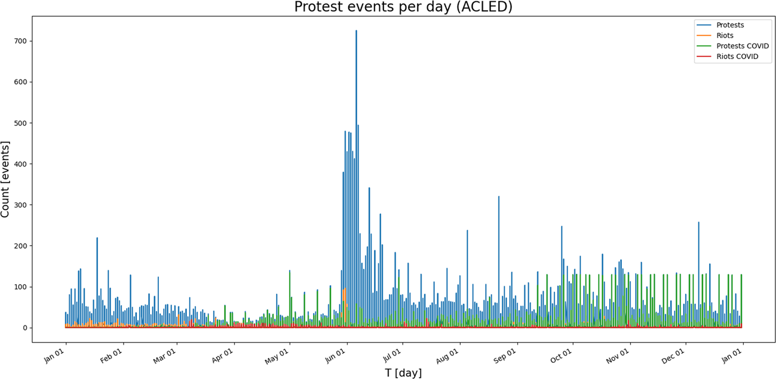
COVID-19
Protests and riots linked to the COVID-19 pandemic
The uncertainty about the effects of a pandemic spreads fear amongst people
The containment measures impose large-scale behavioral changes, and place a psychological burden on individuals
Interactions between individuals ensure that individual perceptions can spread, which leads to the emergence/amplification of tensions at societal level.
This resulted in several civil resistance movements against governmental institutions.
Beyond Covid-19:
During the outbreak of EBOLA and SARS in West-Africa and Canada, similar patterns of protests and stigmatization were observable in West-Africa and Canada

Slide 23
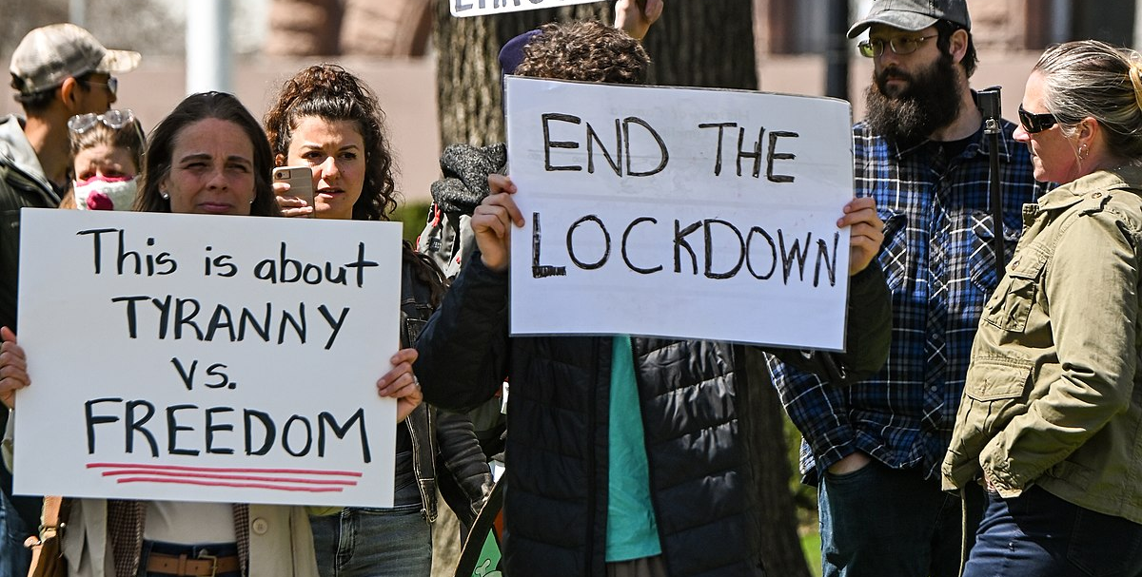
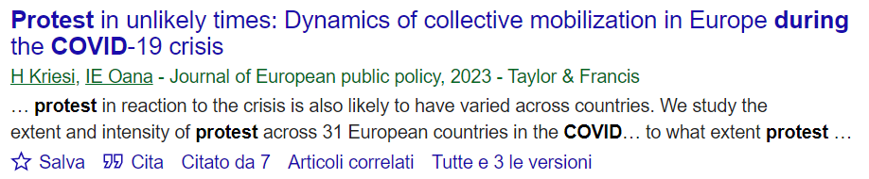
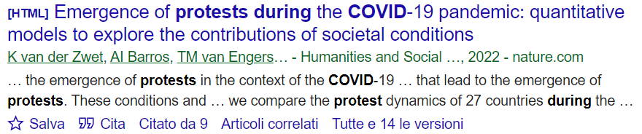
Protests and Covid-19
Protests didn’t stop to occur, but they did at significantly lower levels compared to pre-COVID times, in terms of :
number of events number of participants
Identify key conditions that lead to the emergence of protests.
These conditions and underlying relations are captured in a causal loop diagram to conceptualise the emergence of civil resistance.
compare the protest dynamics of 27 countries during the pandemic

Slide 24
Inverse relation : conflict exacerbates the effects of climate change
By means of environmental and socio-economic degradation, conflict can increase societies' vulnerability to climate change.
The changes occur within natural, social, and economic systems, which may generate complex and unpredictable sequences of events.
scarcity of resources
Climate change
Increased vulnerability
Conflict
(Climate Change as a Driver for Armed Conflict, Zahra Ali Imran 2021)

Slide 25









DATASETS

Slide 26
A few research questions
How does climate change/extreme weather events affect migration/conflicts/protests?
What is the causal chain linking climate and conflicts in a specific region?
By exploring the link among environment/climate variables, socioeconomic and conflict data, is there a certain set of circumstances for conflict to trigger? And how much do these variables influence conflicts?
Is it possible to identify pockets of vulnerability/conflict areas using historical data?
What are the mayor drivers of conflict in a certain area?
What is the connection between climate change and cooperation?
Is conflict triggered by resource abundance or degradation? Does societal stability depend on natural resources?
How did Covid affect the presence of protests around the world?
What is the relationship between societal conditions and the emergence of protests in the context of the COVID-19 pandemic? Can we build a causal loop diagram?
Inverse relation : does conflict exacerbate the effects of climate change? Will societal stability lead to climate mitigation?
Does the increase in (food/grain) prices following heatwaves/natural disasters/epidemics trigger social unrest?

Slide 27
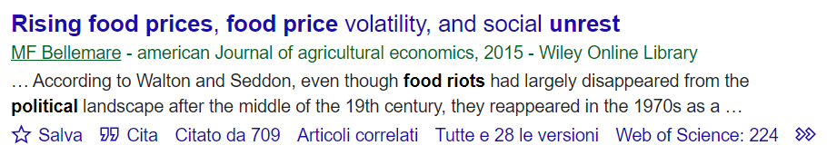
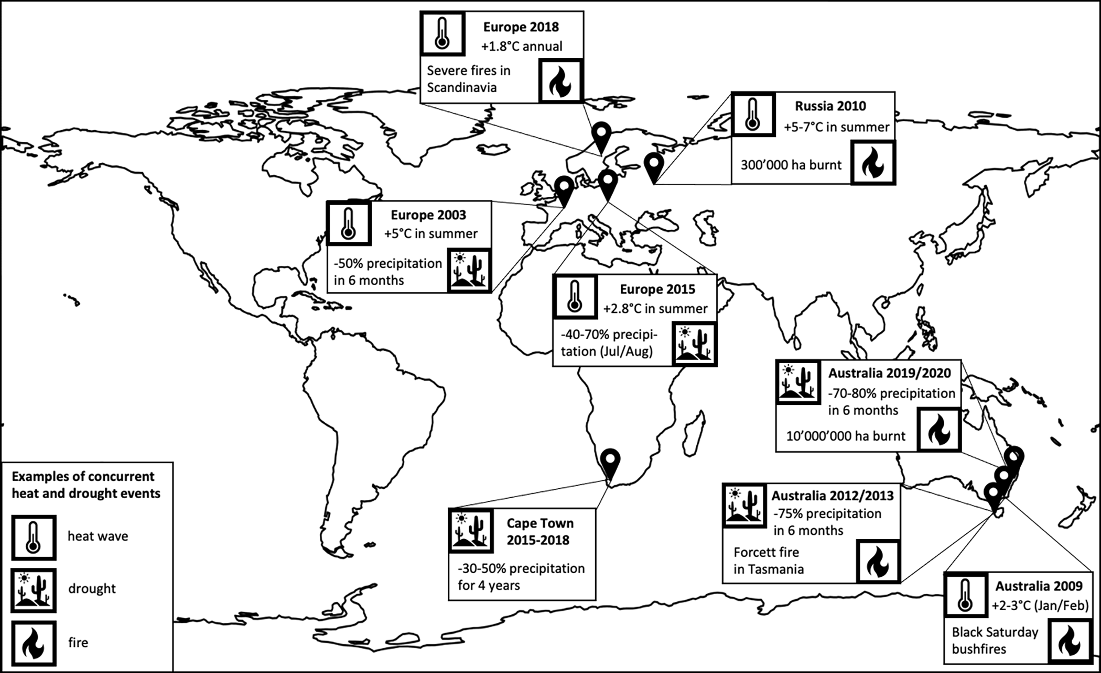
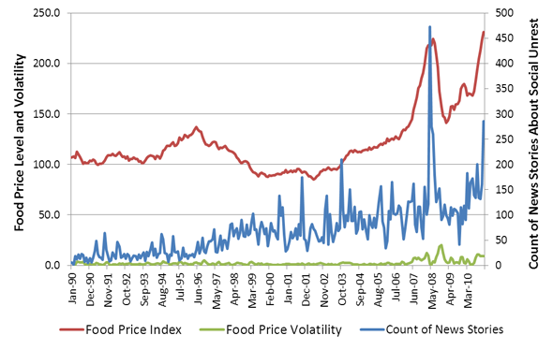
Increase in food prices and social unrest
This article studies the impact of food prices – food price levels as well as food price volatility – on social unrest. Because food prices and social unrest are jointly determined, data on natural disasters are used to identify the causal relationship flowing from food price levels to social unrest.

Slide 28


Slide 29

Rainfall, Rainfall anomalies, NDVI, NDVI anomalies, Rainfall & NDVI, Rainfall & NDVI anomalies

